Slide 1

Some Applications of Regular Expressions
Dr. Sohail Iqbal

Slide 2
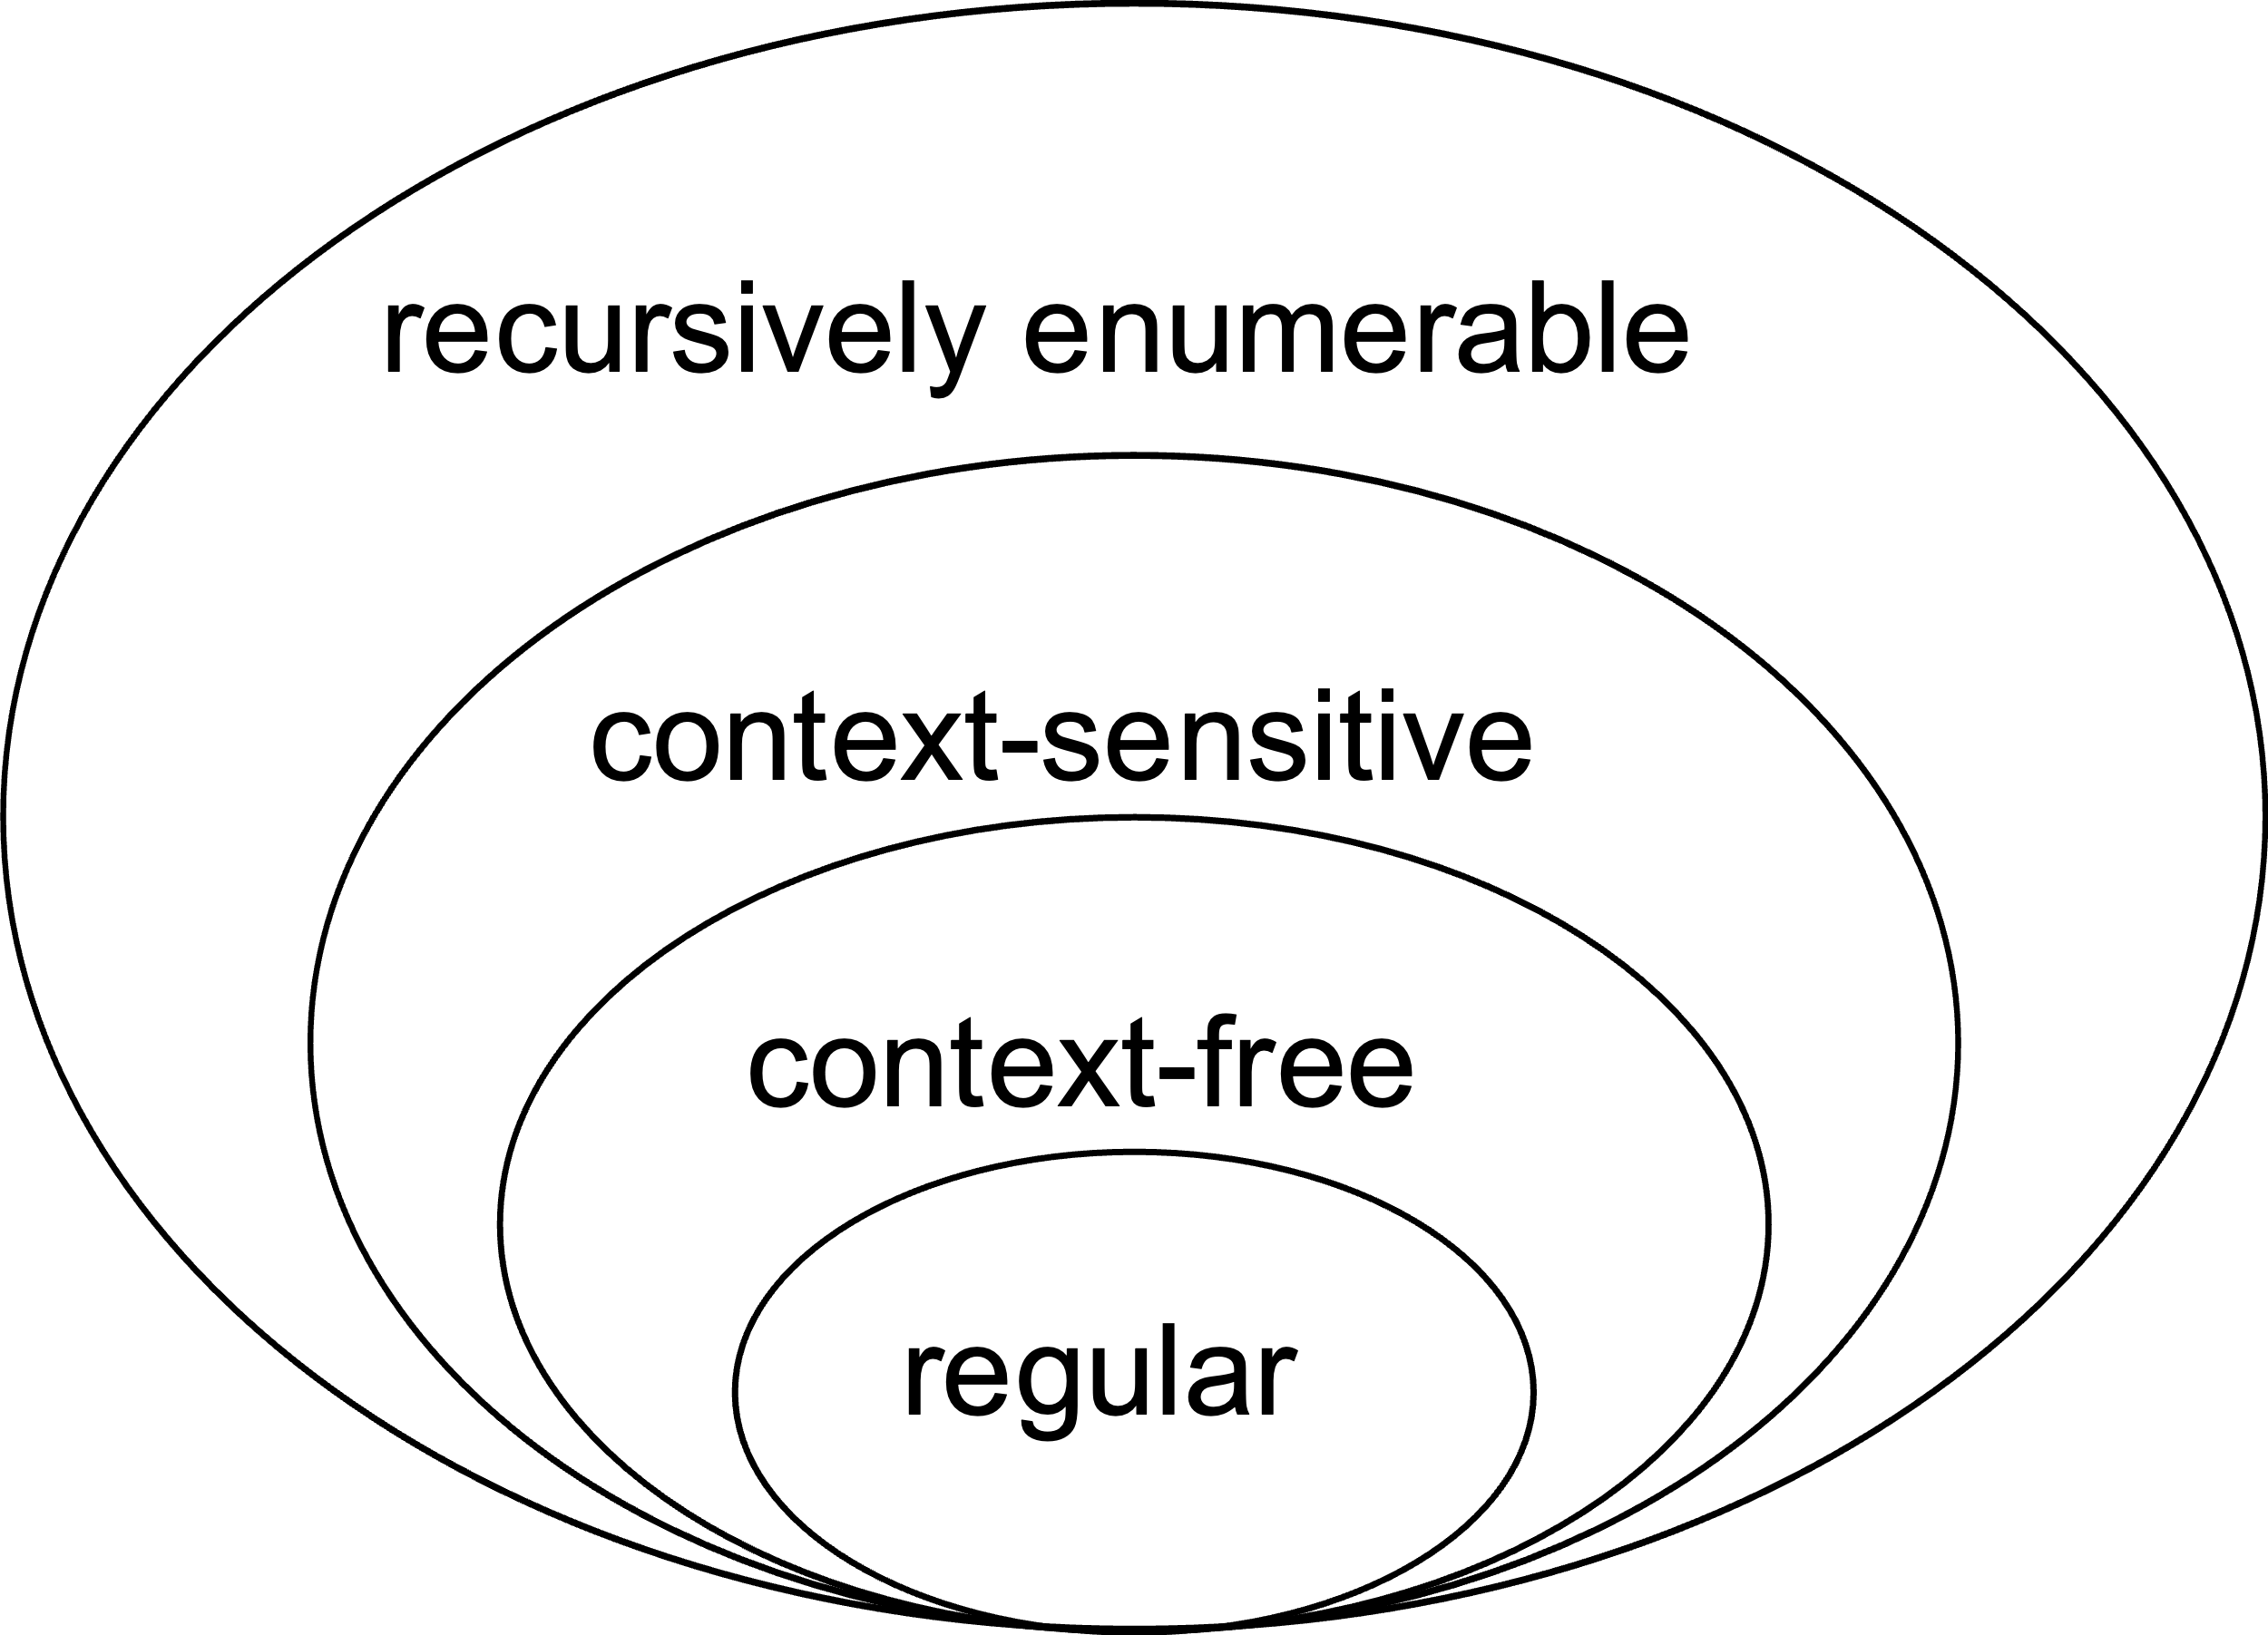
Chomsky Hierarchy of formal languages

Slide 3
Recap: Regular Expressions
Regular expressions
describe regular languages
Example: describes the language
Next, we see how this language is created… and what is the advantages of having strings in pattern

Slide 4
Recap: Standard Representations of Regular Languages
Regular Languages
DFAs
Regular
Expressions
NFAs

Slide 5
Given HBL A/C, generate IBAN
What is an IBAN IBAN stands for International Bank Account Number and is a number attached to all accounts in the EU countries.
The IBAN is made up of a code that identifies the country the account belongs to, the account holder's bank and the account number itself. The IBAN makes it easier and faster to process cross-border payments.

Slide 6
Facilitating bank payments
Is our 14 digit account is good enough for international payments?
(e.g. 2292 7906 3814 03)
How to avoid telling about
HBL
NUST H-12 branch
Pakistan

Slide 7
How is an IBAN constructed
The number comprises maximum 34 alpha-numerical characters, which are structured as follows:
Two letters representing the home country of the account-holding bank (ISO 3166 country code with two letters, e.g. PK for Pakistan, GB for UK)
Two numbers that are a control key
Maximum of 30 alphanumeric characters that identify the bank and the ordinary account number
Notes:
What is control key: This is used for checking the combination of bank number and bank account number

Slide 8
Solution
Concatenate the country and control key before the HBL NUST account.
Eg. HBL NUST A/C number
2292-7900-3425-03 (14 Digits, HBL standard)
We have to find the string for HBL Pakistan and concatenate before the a/c number
Eg. PK-22-HABB-0022927000649601
Notes:
PK is the country code, 22 is the control key, HABB is the bank identifier. To generate the swift key for a Pakistani bank concatenate PKKA after bank identifier.

Slide 9
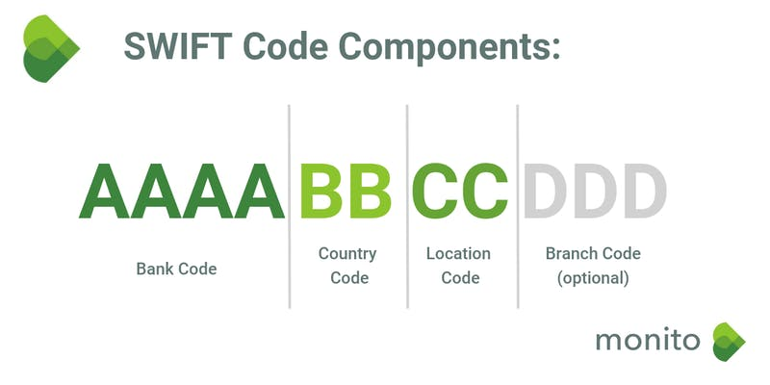
SWIFT codes are used to identify the recipient’s bank network, and when used together with other information like bank identifiers and account numbers, they can verify exactly where transferred money should be deposited.
https://www.monito.com/en/wiki/swift

Slide 10
Given the IBAN, Generate Pakistan Bank’s Swift Key
PK85MEZN0003040101443855
Bank identifier: MEZN
Therefore, Swift Key would be: MEZN PKKA
PK22HABB 0022927000649601
Bank identifier: HABB
Therefore, Swift Key would be: HABB PKKA
link: http://www.businessdictionary.com/definition/SWIFT-code.html
Notes:
Society for Worldwide Interbank Financial Telecommunication code. An internationally-recognized identification code for banks around the world. SWIFT codes are most commonly used for international wire transfers and are comprised of 8 or 11 alphanumeric characters. Read more: http://www.businessdictionary.com/definition/SWIFT-code.html

Slide 11
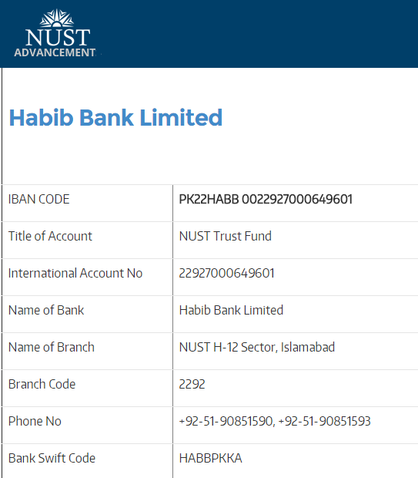

Look at the above form, filled by a user . Find what can you do to help the user to get the same form with minimum entries?

Slide 12
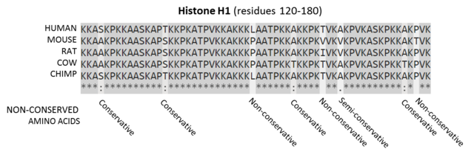
DNA String Matching

Slide 13
More Applications/Examples
Email Addresses
Valid Dates
Deleting Duplicate Lines etc.
For details, please visit:
http://www.regular-expressions.info/examples.html

Slide 14
Thank You!

